Slide 1
PROJECT → SKILL → CAREER
PROJECTS
FORGE
From Project Ideas to Career-Ready Skills
Helping engineering students discover, build, document and explain the right projects.
PROJECTSFORGE
01

Slide 2
02 / PROJECTSFORGE
The problem: a fragmented search path
Student needs
a project
Seniors
Google
YouTube
ChatGPT / AI
GitHub
Professor
Still unsure
Too many choices
Skill mismatch
Poor planning
Unreliable resources
Documentation friction
Hard to explain work
HYPOTHESES TO VALIDATE — not proven facts
PROJECTSFORGE
02

Slide 3
03 / PROJECTSFORGE
How students currently solve it
YT
YouTube
AI
ChatGPT / AI
GH
GitHub
Tutorials & walkthroughs
Ideas & explanations
Code & examples
PR
Professors
SR
Seniors
WEB
Project sites
Domain guidance
Lived experience
Browsable idea lists
Students have many resources — but the project journey remains fragmented.
PROJECTSFORGE
03

Slide 4
THE KEY QUESTION
If ChatGPT can give students project ideas, why would they need ProjectsForge?
AI
Ideas
YouTube
Learning
GitHub
Examples
Professor
Guidance
ProjectsForge
Connects journey
ProjectsForge complements existing tools with a structured workflow.
PROJECTSFORGE
04

Slide 5
05 / PROJECTSFORGE
What existing platforms provide — and what to test
PLATFORM
PROVIDES
POTENTIAL GAP PROJECTSFORGE WILL TEST
YouTube
Tutorials, demos
Continuity from idea to evidence
ChatGPT / AI
Ideas, explanations
Structured ownership & checkpoints
GitHub
Code, repositories
Skill-fit and guided progression
Professors
Expert guidance
Scalable follow-through
Generic project sites
Idea lists
Personalized execution support
Neutral comparison • gaps are hypotheses for validation
PROJECTSFORGE
05

Slide 6
06 / PROJECTSFORGE
One structured journey
1 Profile
2 Personalized recommendations
3 Prerequisites
4 Learning resources
5 Project roadmap
6 Milestones
7 Build
8 GitHub / demo / evidence
9 Documentation
10 Viva & presentation
11 Interview preparation
PROJECTSFORGE
06

Slide 7
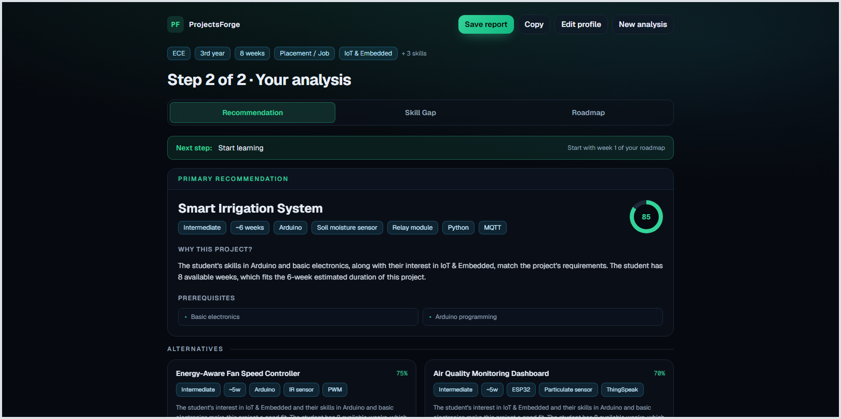
07 / PROJECTSFORGE
Personalized project discovery
Recommended for you
STUDENT PROFILE
3rd year
Electronics & Communication
Arduino, C, basic electronics
IoT & Embedded
8 weeks
AI Waste Classification
Intermediate • 6 weeks
Why this project? Matches Python interest; introduces computer vision with a clear demo.
Smart Energy Monitor
Beginner • 4 weeks
Why this project? Builds embedded fundamentals around a sustainability use case.
Campus Water Audit
Beginner • 3 weeks
Why this project? Low-cost data project with measurable field evidence.
REAL SCREENSHOT — WORKING APP, LOCAL LLM
PROJECTSFORGE
07

Slide 8
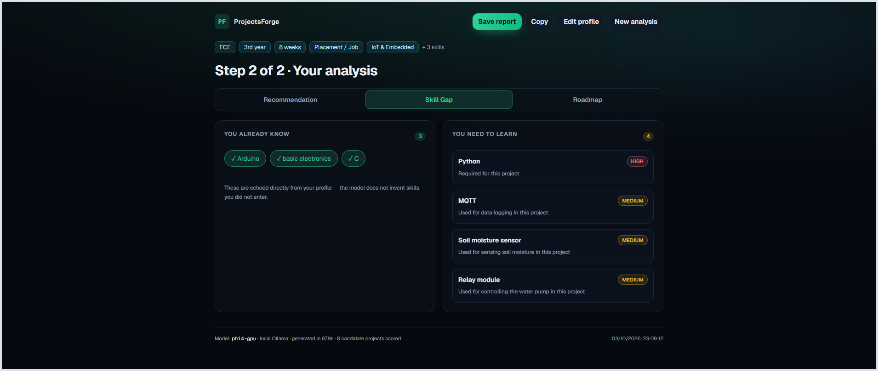
08 / PROJECTSFORGE
Skill-gap analysis — built and working
Turn a real problem into a build plan
AI WASTE
CLASSIFICATION
Problem statement
Classify common waste categories and explain model decisions.
Intermediate
6 weeks
Python • Vision
Skills required / learned
Tech stack
Prerequisites
Architecture
Milestones
Learning resources
Deliverables
GitHub + demo
Documentation
Viva + interview questions
PROJECTSFORGE
08

Slide 9
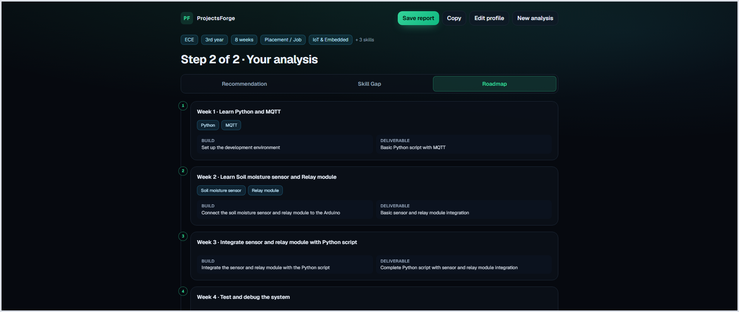
09 / PROJECTSFORGE
Week-by-week roadmap — built and working
✓
Define categories & dataset
3 / 6
MILESTONES
✓
Clean and label images
✓
Train baseline model
Evaluate errors
Build demo interface
Record evidence & reflection
I’m stuck
Ask for guidance
Upload evidence
PROJECTSFORGE
09

Slide 10
10 / PROJECTSFORGE
Validate before scaling
Interview
students
Interview
seniors
Interview
professors
Find repeated
problems
Manual
recommendations
Collect
feedback
Build
prototype
Build
MVP
Evidence-driven development. No premature large platform.
PROJECTSFORGE
10

Slide 11
11 / PROJECTSFORGE
Ask about behavior, not approval
1
“When you need a college project, where do you usually find the idea?”
2
“What was difficult after selecting the project?”
3
“How did you know the project matched your skill level?”
4
“What did you use ChatGPT for?”
5
“What was still difficult after using those tools?”
6
“What would you change about your project experience?”
AVOID: “Do you like ProjectsForge?”
PROJECTSFORGE
11

Slide 12
12 / PROJECTSFORGE
MVP: only the essential loop
✓ 01
Student Profile
✓ 02
Project Database
✓ 03
Personalized Recommendations
✓ 04
Skill-Gap Analysis
✓ 05
Week-by-Week Roadmap
✓ 06
Save / Export Report
All six are built and working today — profile to export, end to end.
PROJECTSFORGE
12

Slide 13
13 / PROJECTSFORGE
AI layer — built today
✓ Project recommendation
✓ Skill-gap analysis
✓ Personalized roadmap
Built: recommendation + skill gap + roadmap — local LLM (phi4-gpu), 16-project dataset, ~30 s per analysis. AI supports learning, not copying.
PROJECTSFORGE
13

Slide 14
14 / PROJECTSFORGE
Professor & industry contribution workflow
Professor
Project idea / challenge
ProjectsForge
Suitable students
Build
Feedback
Verified evidence
ATTRIBUTION
PERMISSIONS
Contributor identity stays visible.
Publish, edit and review controls.
PROJECTSFORGE
14

Slide 15
15 / PROJECTSFORGE
Evidence-based project verification
GitHub / code evidence
Mentor / peer feedback
Demo video
VERIFIED
EVIDENCE
Documentation
Screenshots
Student contribution statement
Architecture explanation
Verification means documented evidence — not absolute proof of originality.
PROJECTSFORGE
15

Slide 16
16 / PROJECTSFORGE
Turn a project into career evidence
Project
GitHub
Portfolio
Resume
Presentation
Viva
Interview
Internship / job readiness
“A project should become evidence of what a student can actually do.”
PROJECTSFORGE
16

Slide 17
17 / PROJECTSFORGE
Business model possibilities to validate
Freemium
Premium project workspace
AI / project guidance
College / institution plans
Mentor review
Industry challenge programs
Recruitment / internship partnerships
Test monetization only after proving user value.
PROJECTSFORGE
17

Slide 18
18 / PROJECTSFORGE
90 days: learn, prototype, pilot
WEEKS 1–2
WEEKS 5–6
WEEKS 9–10
Interviews
Manual MVP
Build MVP
Students • seniors • professors
Human-led recommendations
Essential loop only
1
2
3
4
5
6
WEEKS 3–4
WEEKS 7–8
WEEKS 11–12
Find patterns
Prototype
Pilot
Repeated problems
Test the workflow
Observe student use
PROJECTSFORGE
18

Slide 19
19 / PROJECTSFORGE
Success means evidence of value
1
Interviews completed
2
% reporting target problem
3
Testing recommendations
4
Recommendation usefulness
5
Projects saved / started
6
Milestones completed
7
Returning users
8
Professor / mentor contributors
9
Willingness to pay
Track learning signals first — not vanity metrics.
PROJECTSFORGE
19

Slide 20
Students
Internships
Professors
PROJECTS
FORGE
Portfolios
Mentors
GitHub
Industry
Projects
AI
From project discovery to career development
Helping engineering students turn project ideas into real skills and career evidence.
PROJECTSFORGE
20

